Slide 1

Prostate Cancer Identification
Sheethal Sridhar

Slide 2
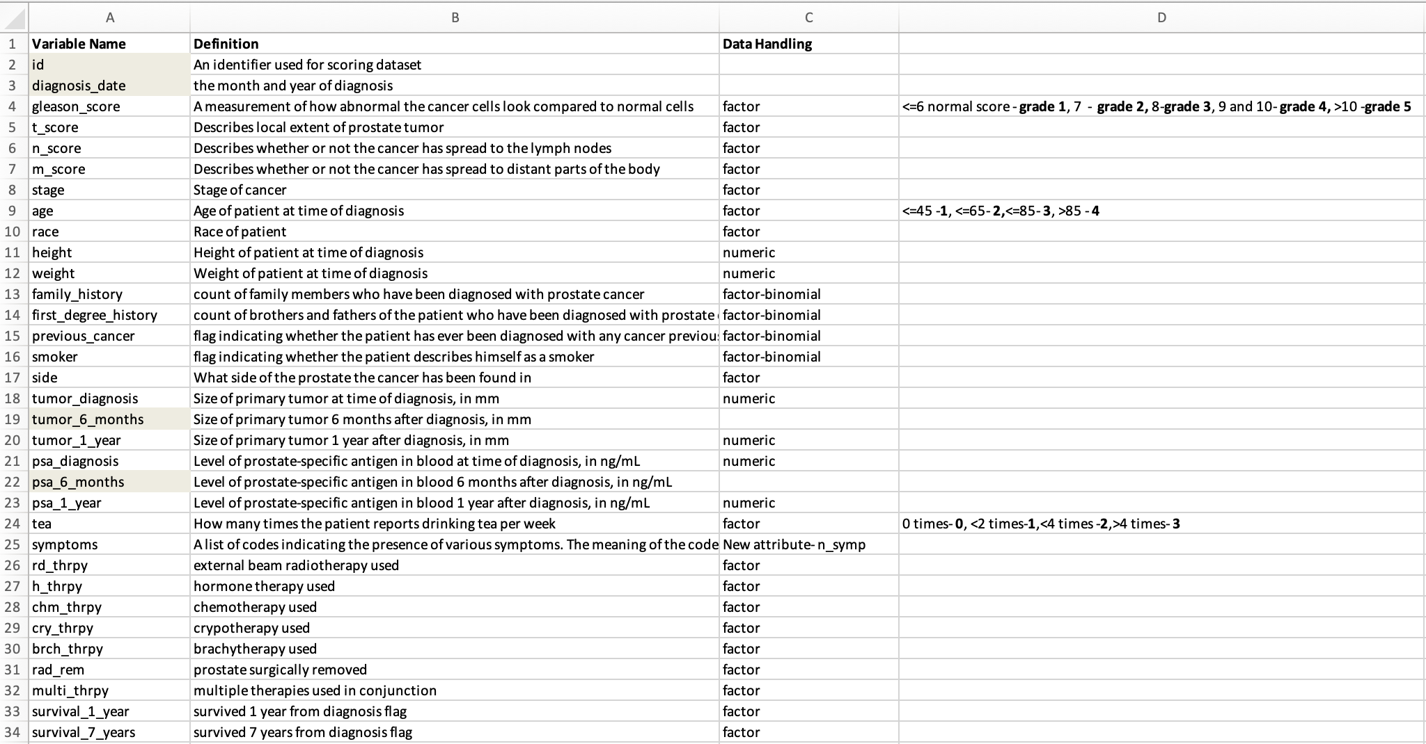
Initial Data -15385 obs of 33 variables After removal of NAs there are 8955 obs of 34 variables
Data Preparation

Slide 3
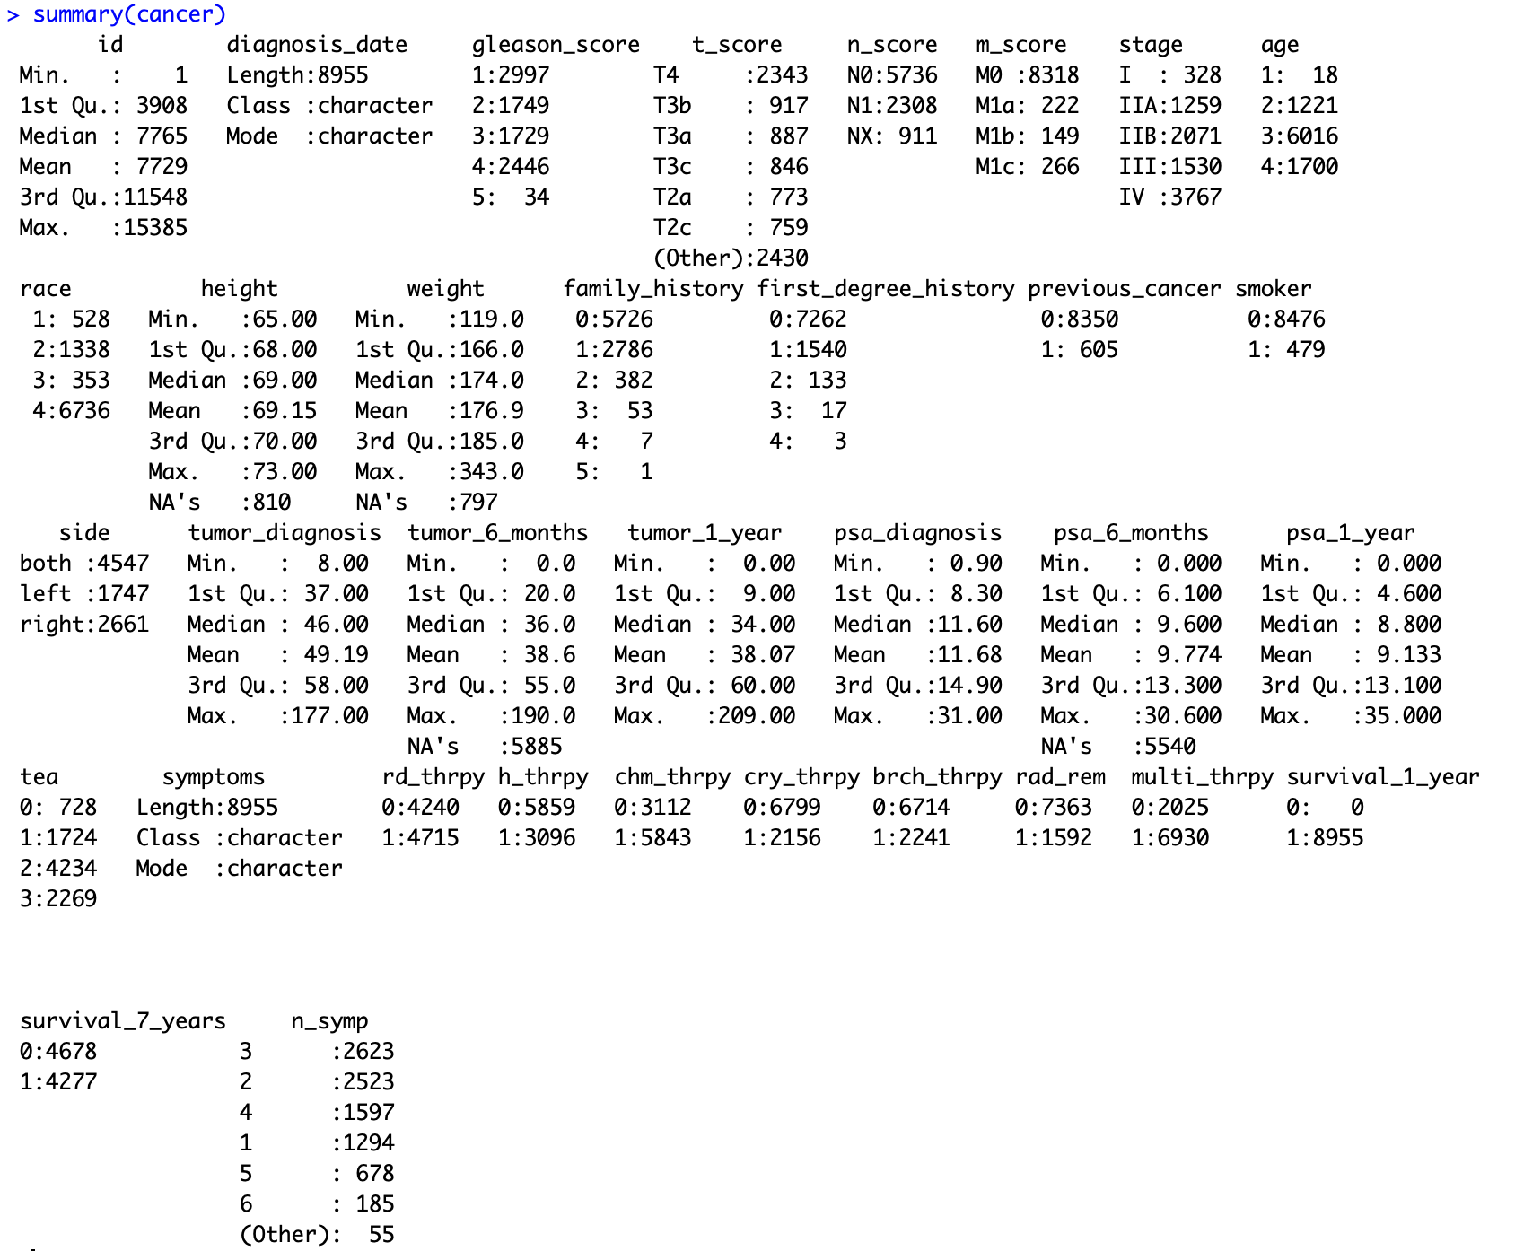
Descriptive statistics

Slide 4
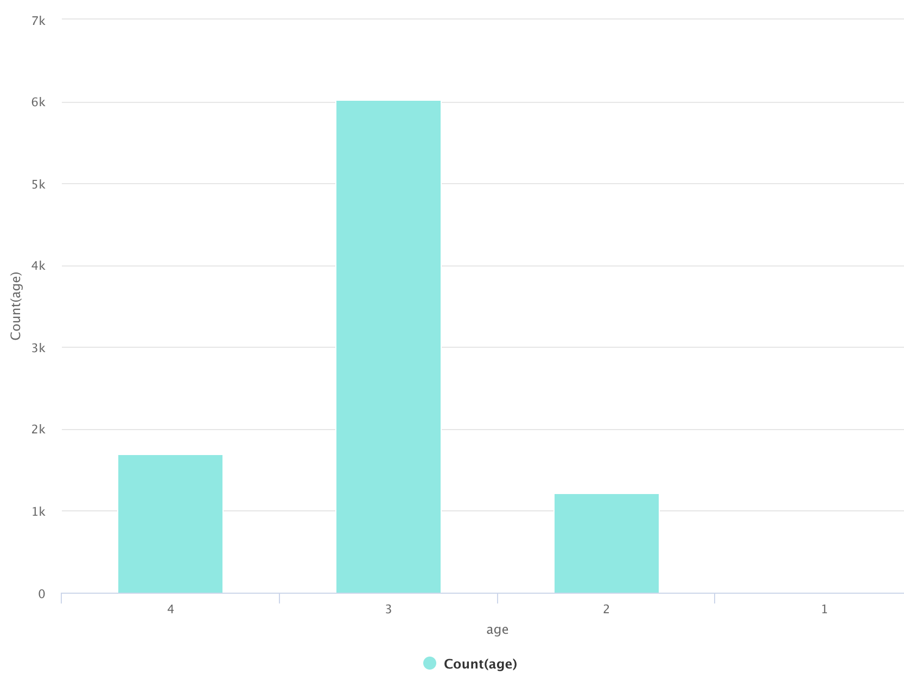
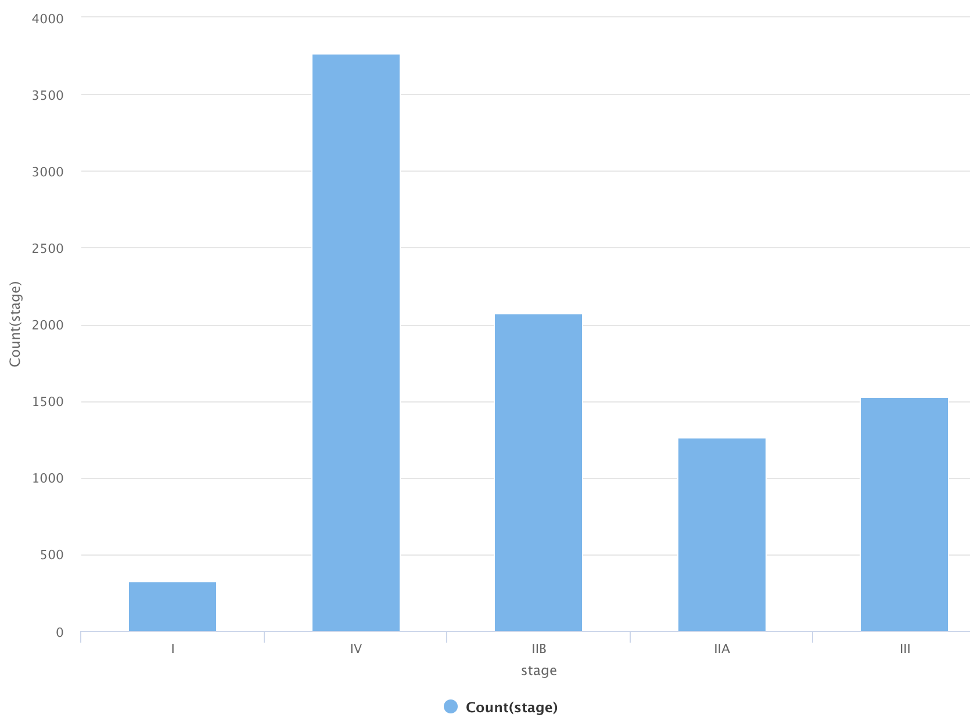
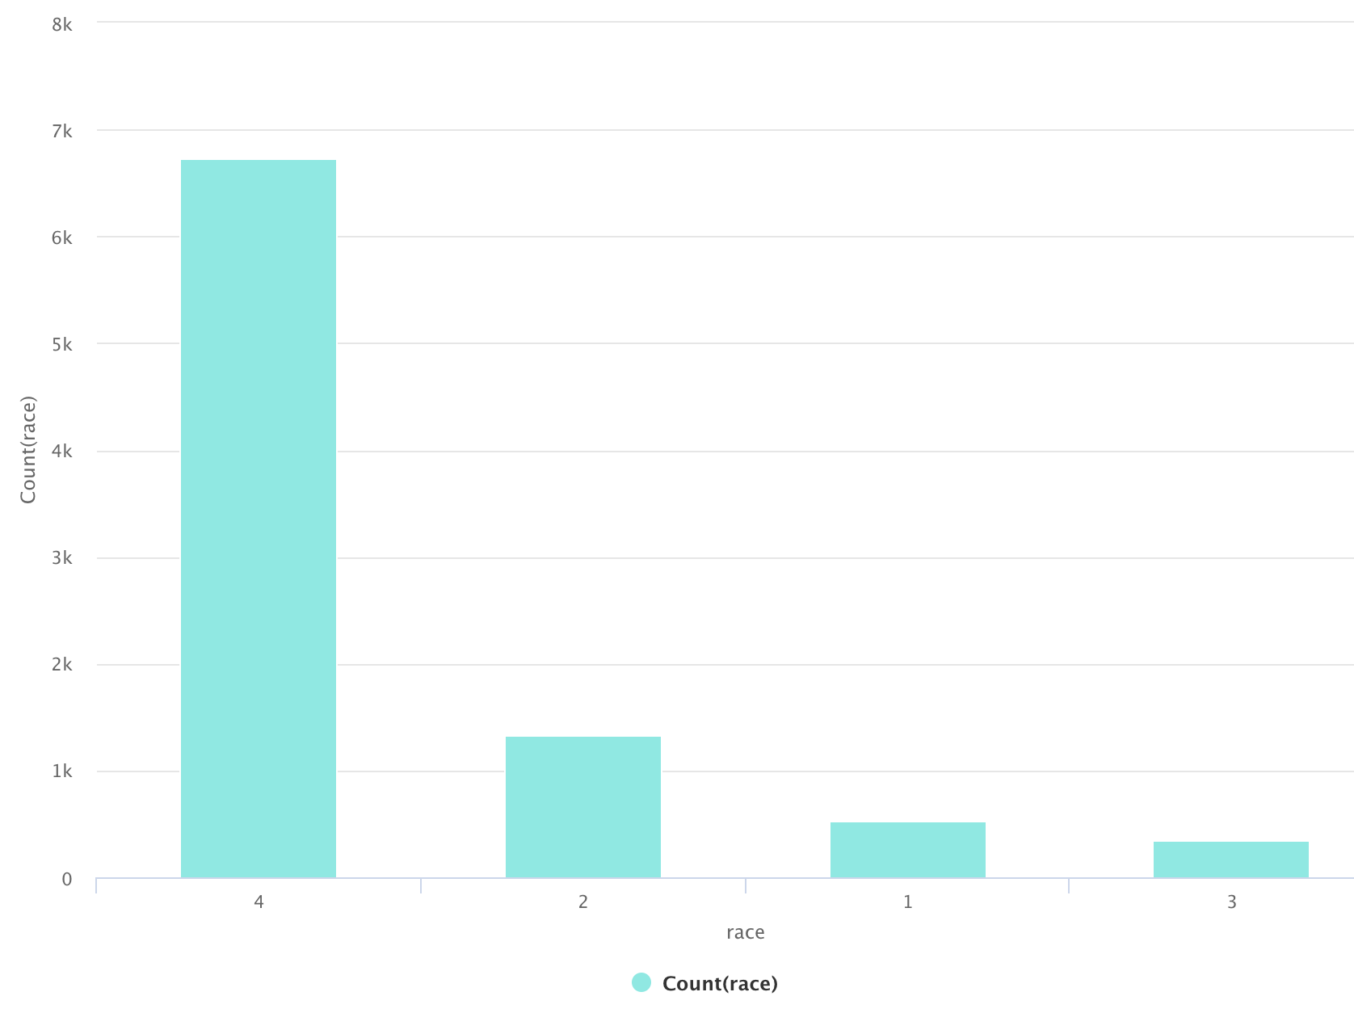
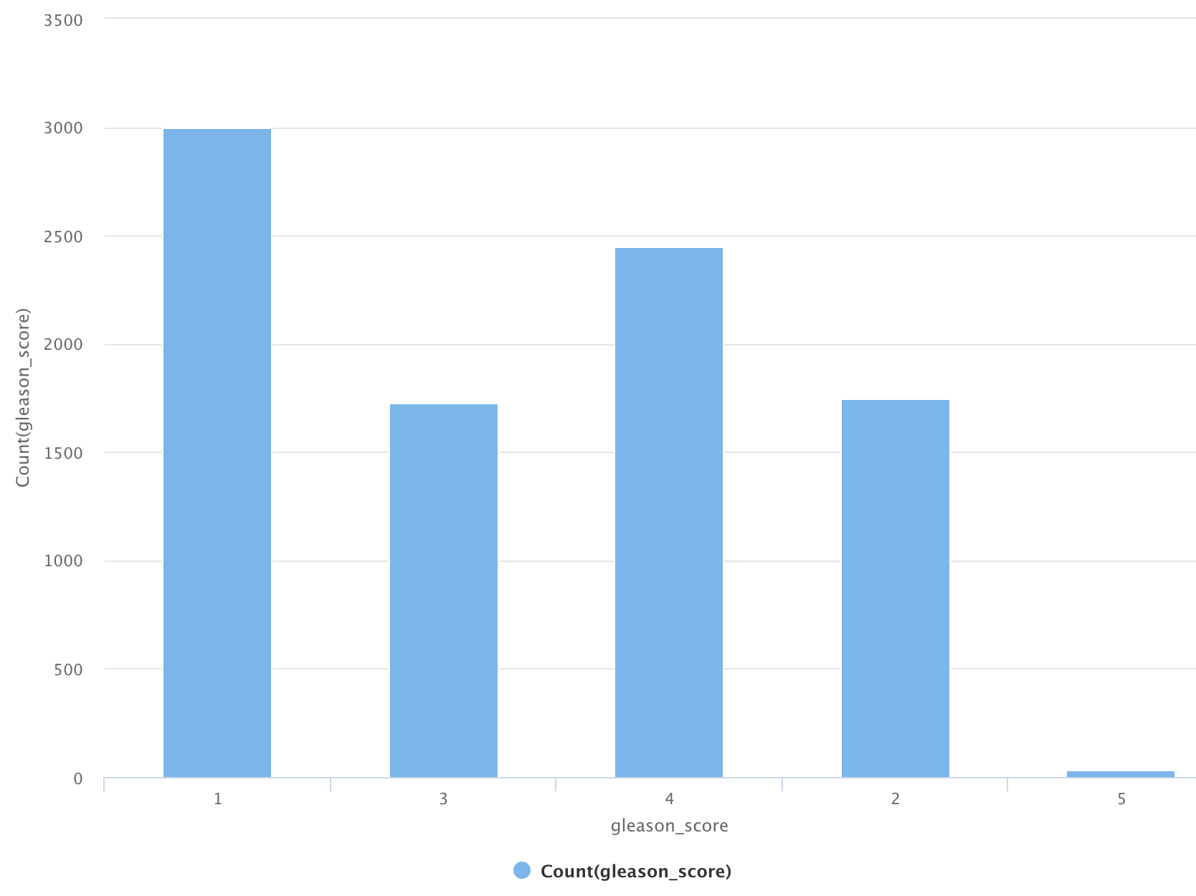
Univariate Analysis
Age group <=85 years has maximum number of patients
Most of the cancer patients are of race category 4

Slide 5
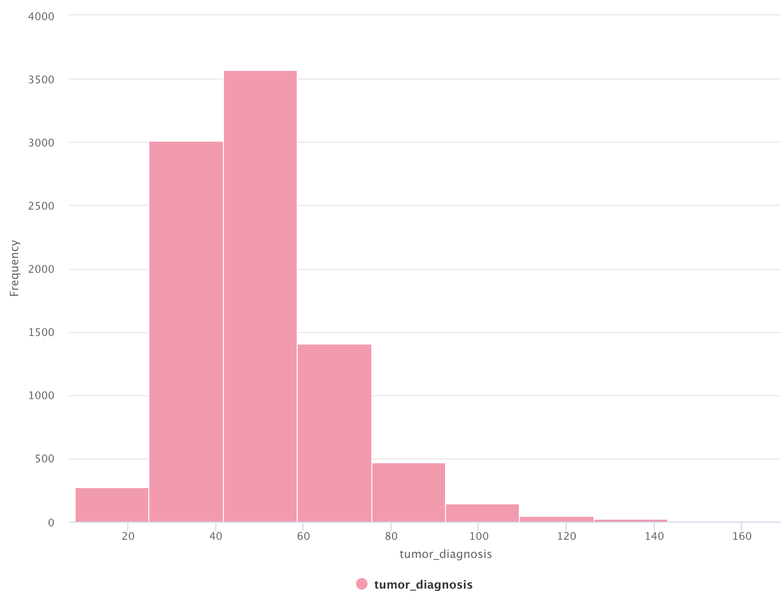
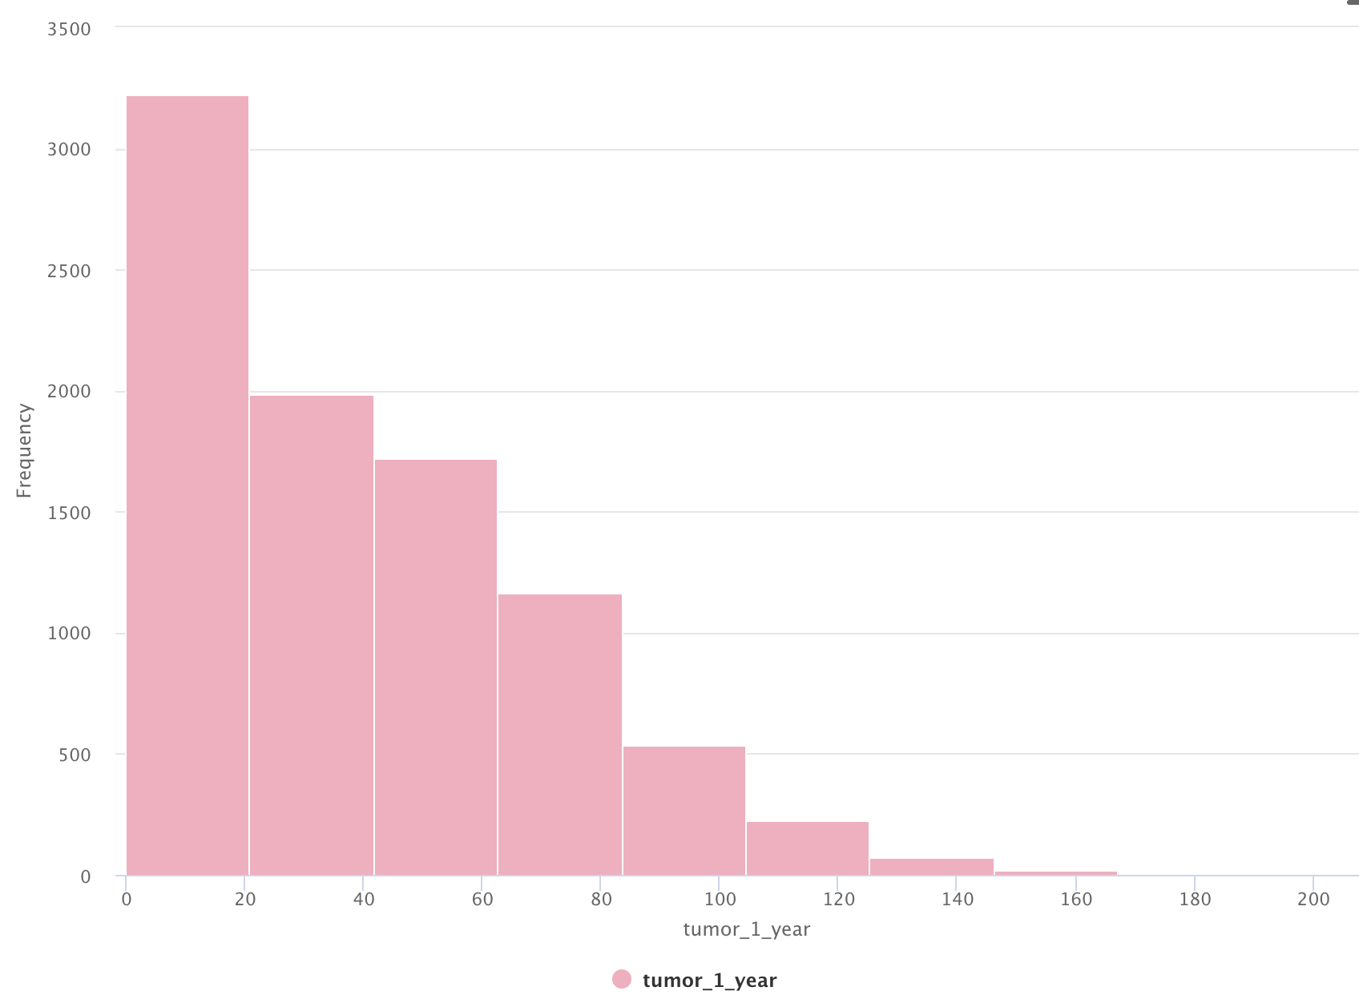
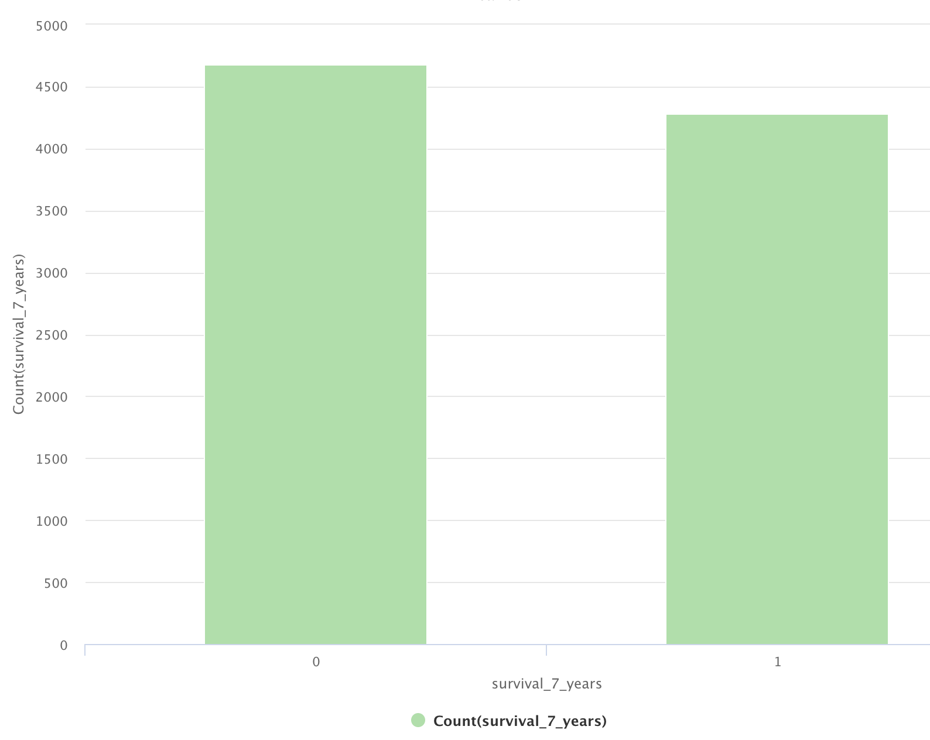
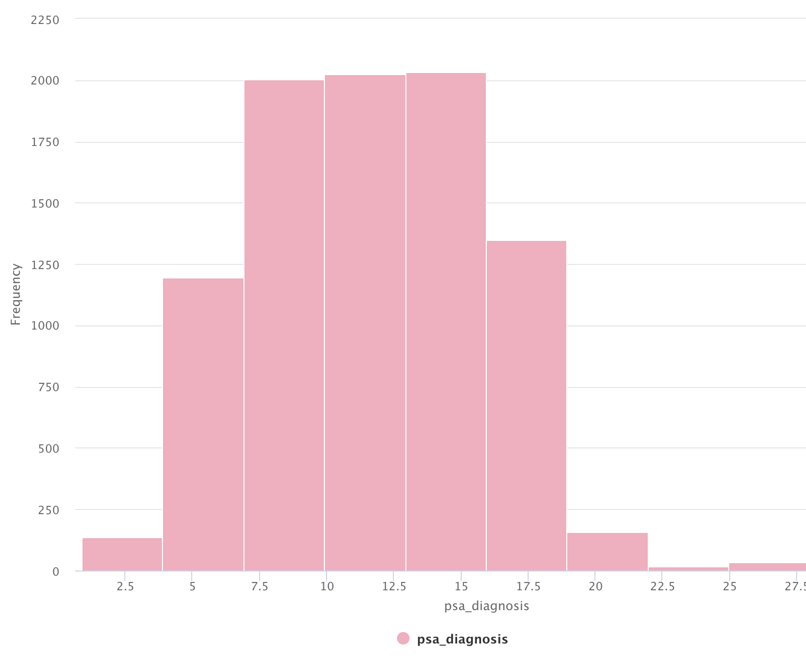
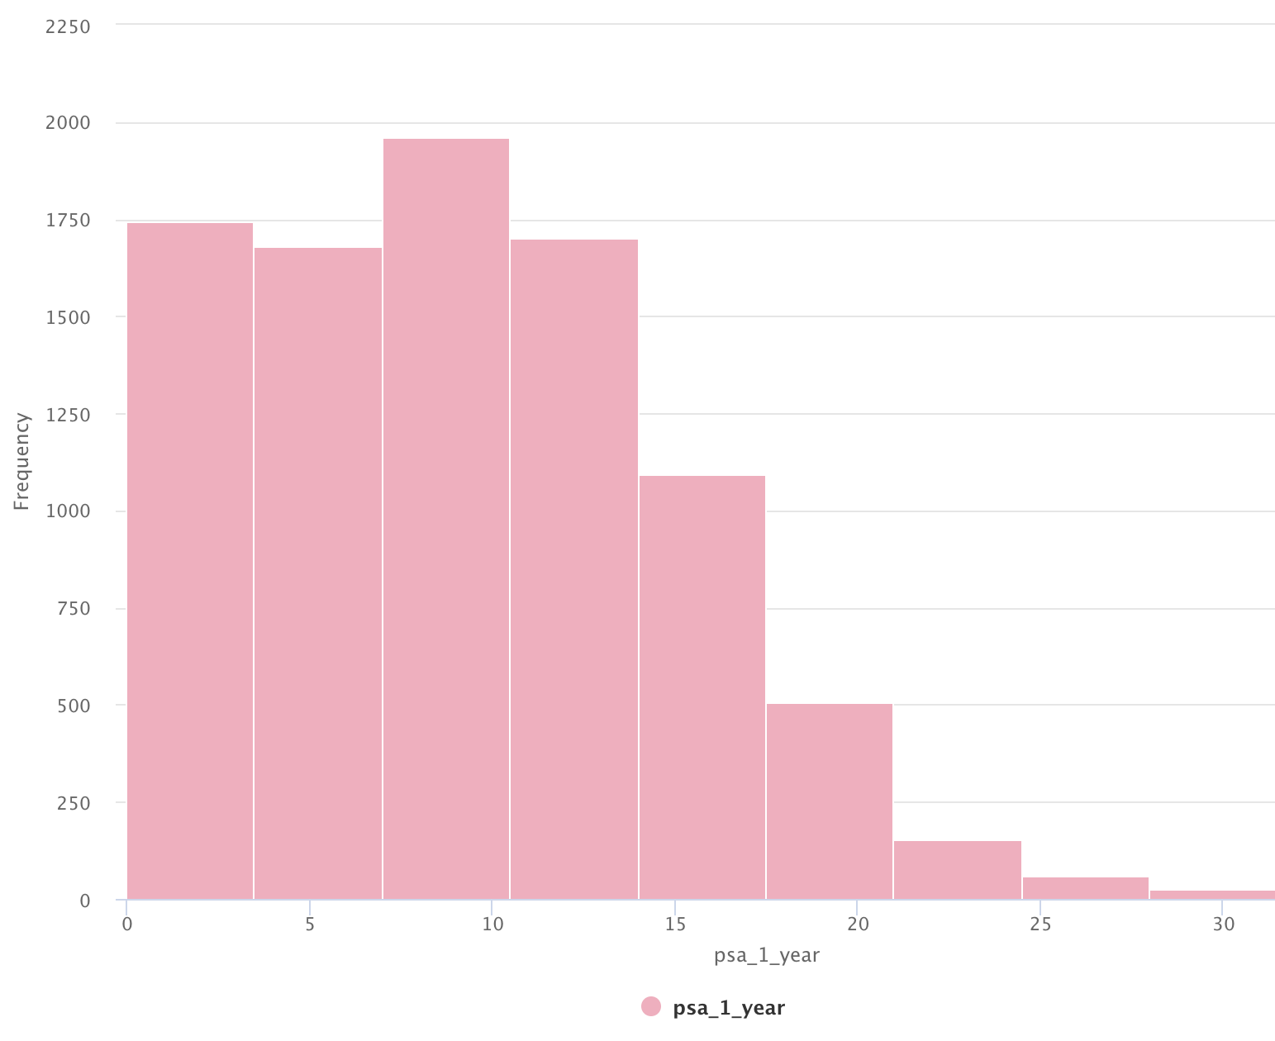
Size of the primary tumor one year after diagnosis
Level of PSA in blood one year after diagnosis

Slide 6
Anova Test Results
Chi Square Test Results
Significant Variables: tumor_diagnosis, tumor_1_year, psa_diagnosis and psa_1_year
Insignificant Variables: height and weight
Significant Variables: gleason_score, t_score, n_score, m_score, stage, rd_thrpy, chm_thrpy, brch_thrpy, cry_thrpy etc
Insignificant Variables: age, race, previous_cancer, side, tea, h_thrpy and rad_rem

Slide 7
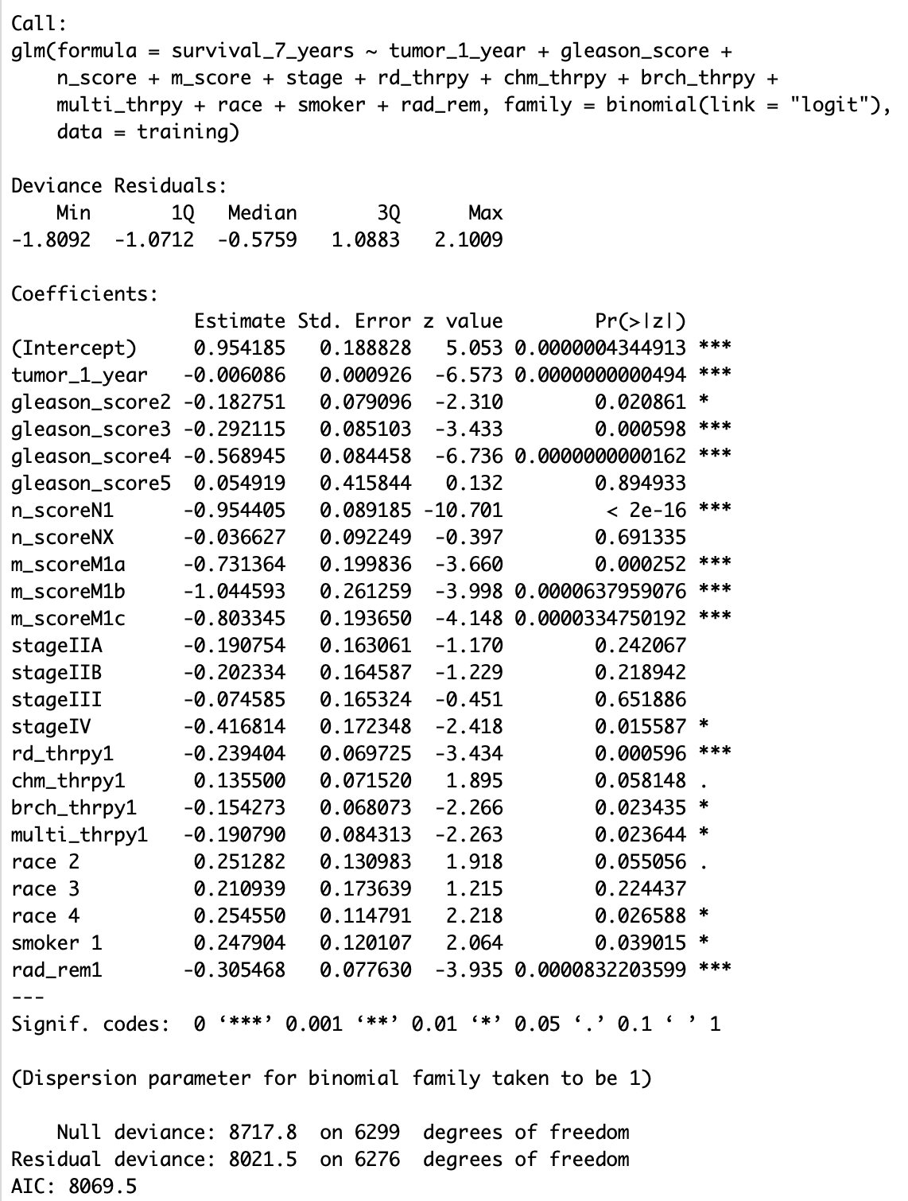

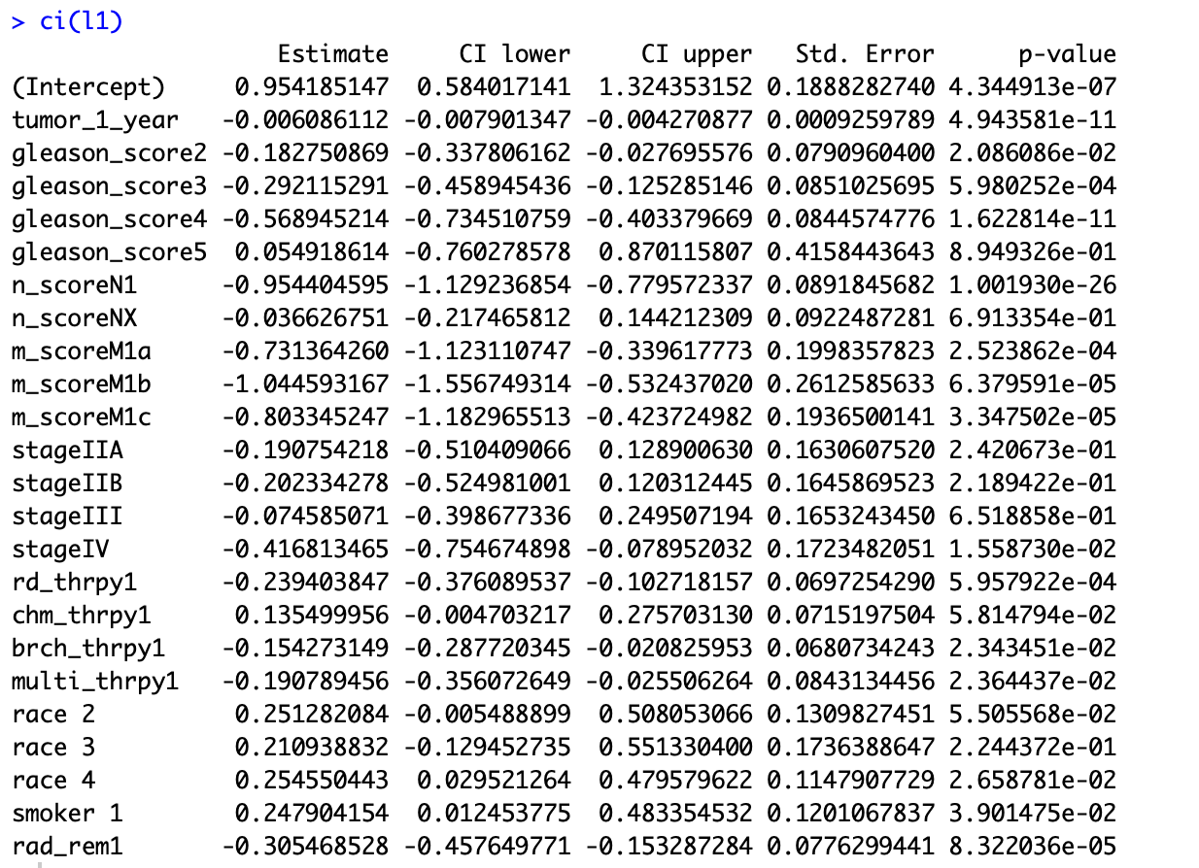
Logistic Regression

Slide 8
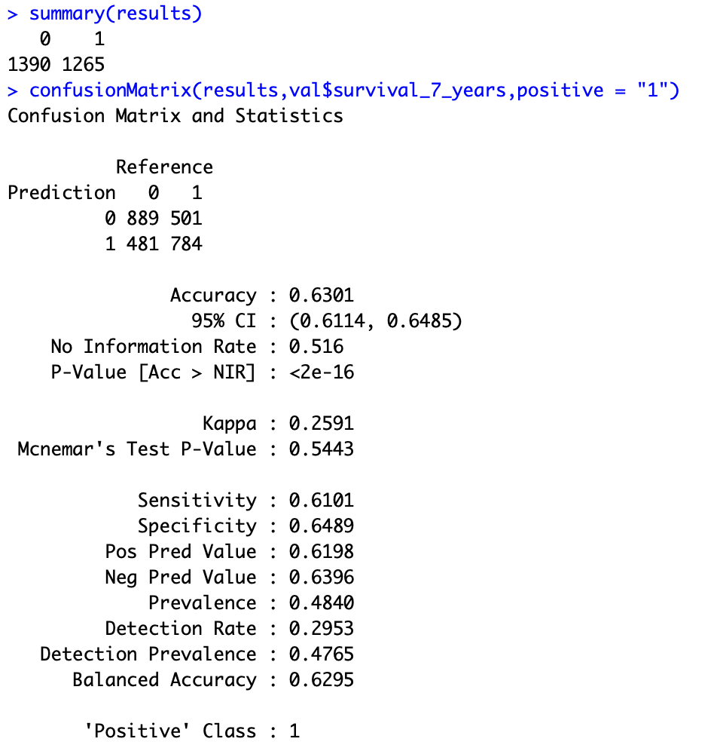
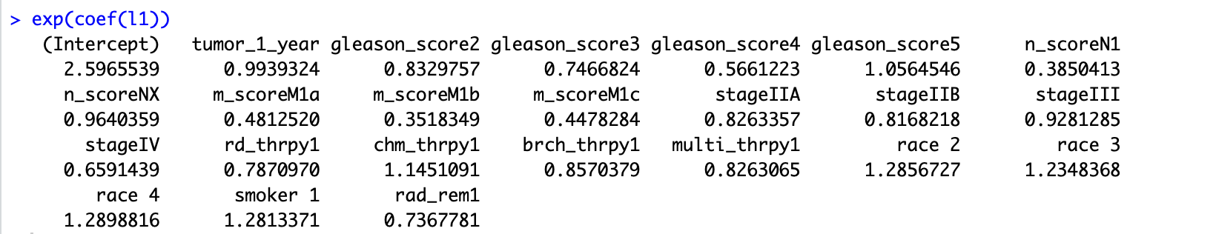

Slide 9
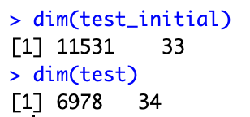
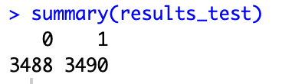
Testing
Patients with the following conditions are less likely to survive:
Gleason score 9-10
N1 score( The cancer has spread to the regional (pelvic) lymph node(s).)
Metastatic prostate cancer (M1a, M1b and M1c)
Stage 4 – The cancer has spread beyond the prostate

